Slide 1


Slide 2
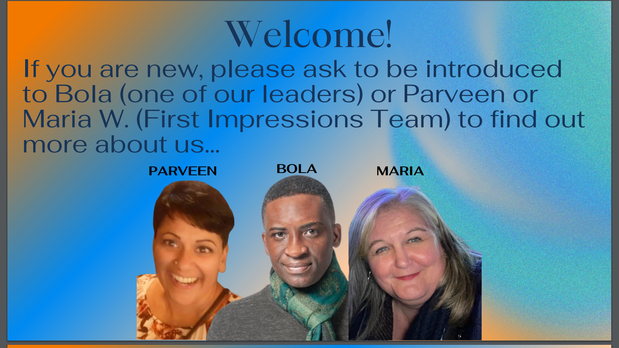

Slide 3
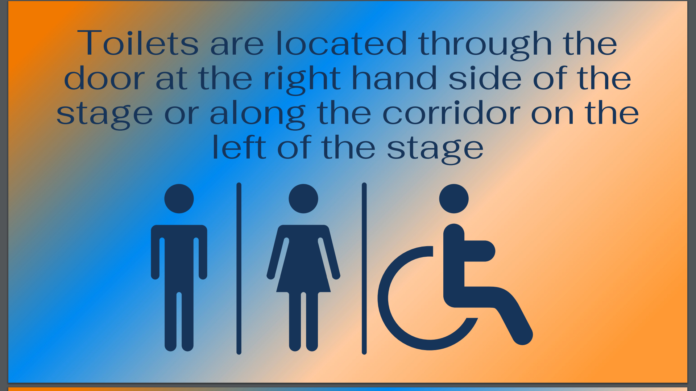

Slide 4
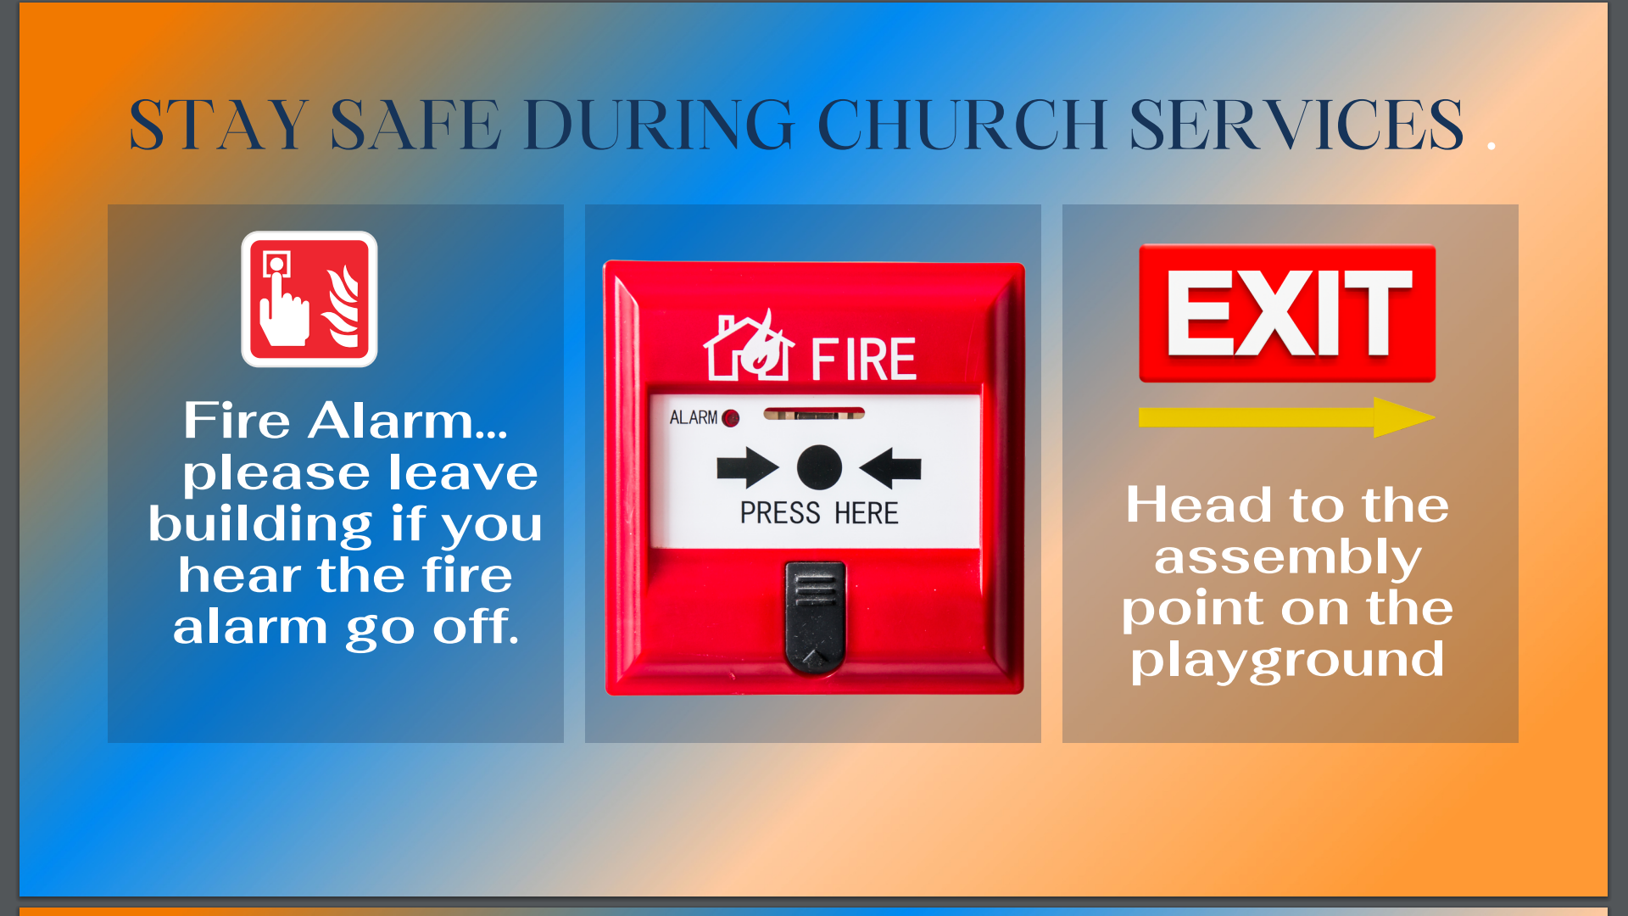

Slide 5


Slide 6
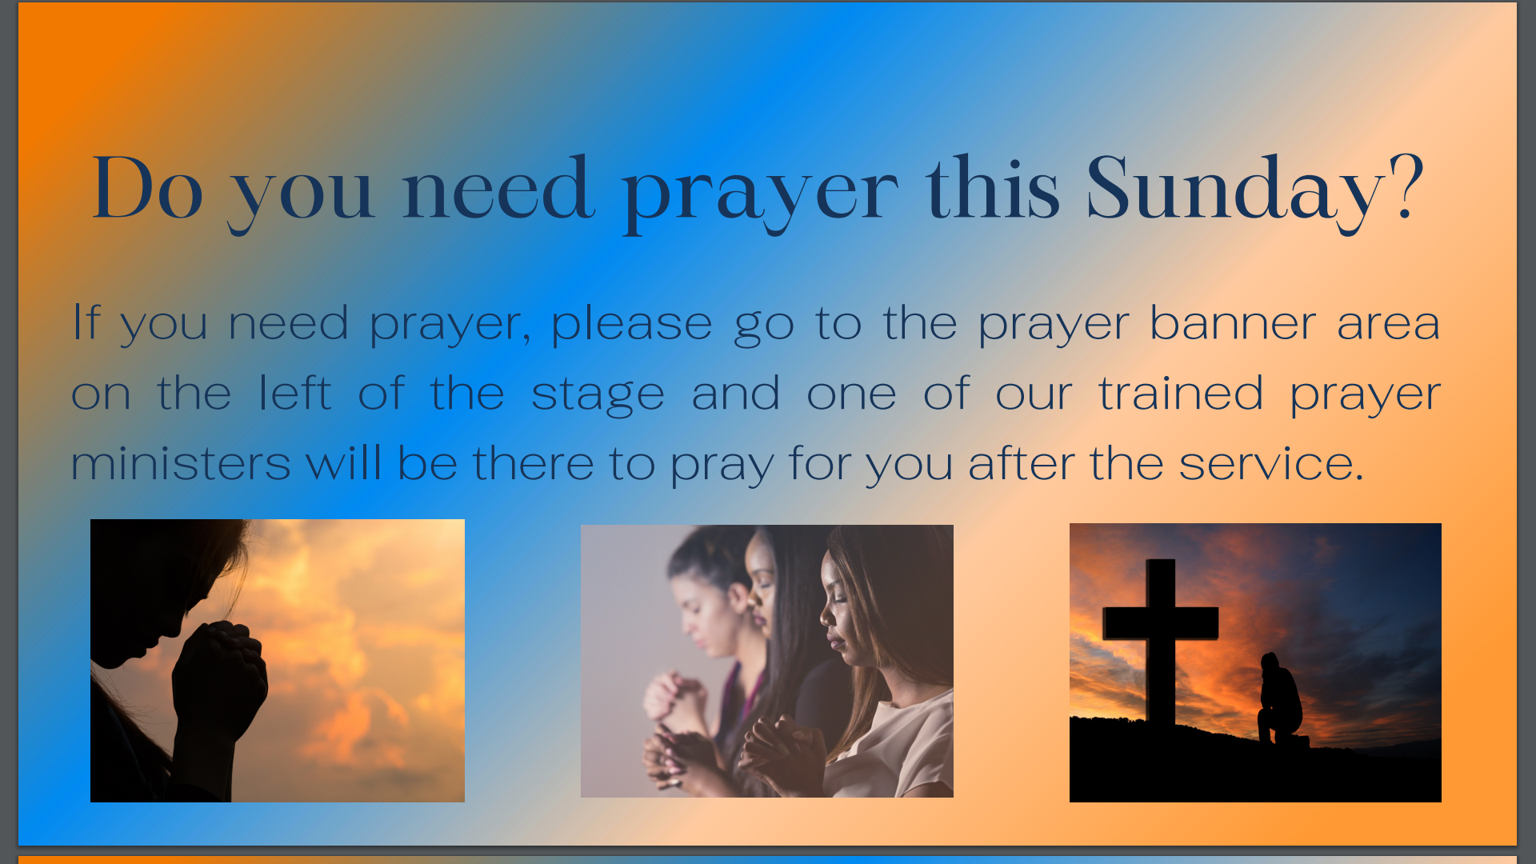

Slide 7


Slide 8
Cornerstone City Church Peninsula Plus Community Hoo Are Ya
3rd March 2024

Slide 9


Slide 10
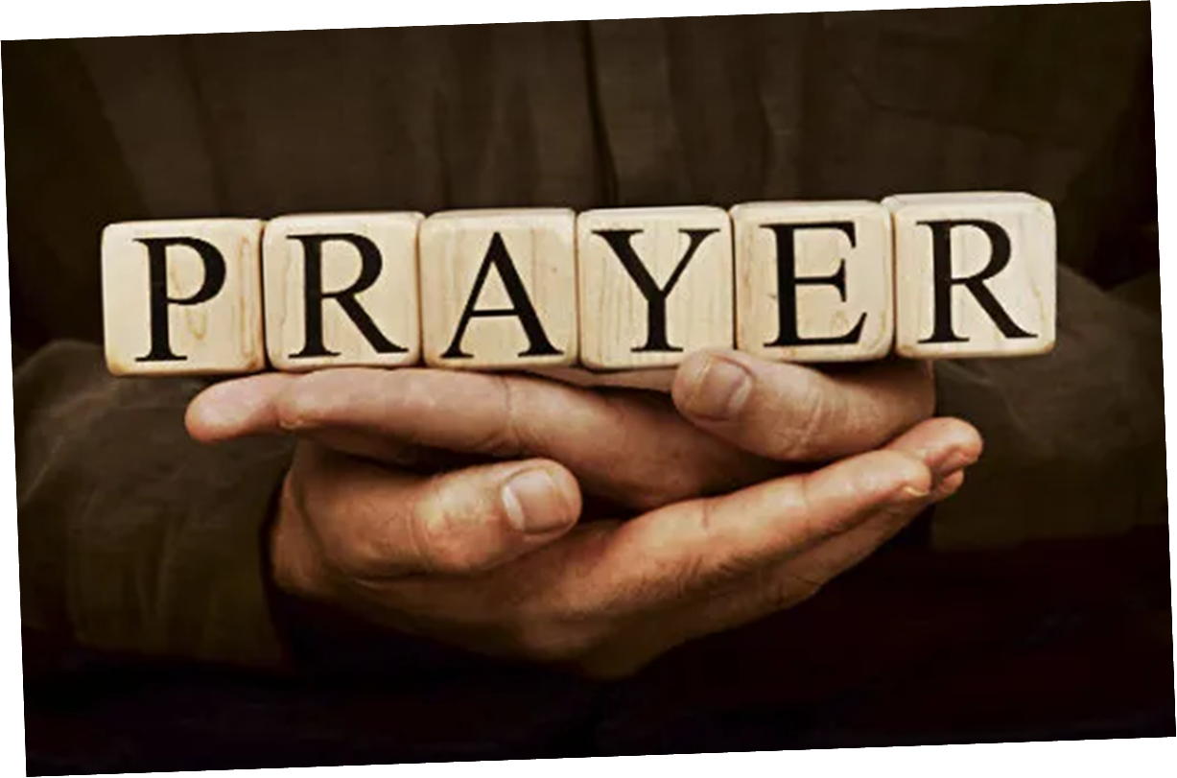

Slide 11


Slide 12
Something About That Name
CCLI Song # 7167032
Anne Wilson | Colby Wedgeworth | Ethan Hulse
© Capitol CMG Genesis; Capitol CMG Paragon; Jacobs Story Music; Wedgeworth Publishing; Be Essential Songs; EGH Music Publishing
For use solely with the SongSelect® Terms of Use. All rights reserved. www.ccli.com
CCLI License # 33265

Slide 13
1/4
Sweeter than the morning
Or the sound of the rain
From the mouth of the preacher
And the sinner the same
Tender as a whisper
But loud in it's refrain
May it hang on my lips for the rest of my days

Slide 14
2/4
There is something about the name of Jesus
It sounds like forgiveness sounds like amazing grace
It beckons my soul to sing forever
There's just something about that name

Slide 15
3/4
We pray it over family
When we rise and when we sleep
We speak it over sorrow
And the soul is given peace
We'll sing it in the famine
Or in prosperity
May we never forget that He is all that we need

Slide 16
4/4
There is still no other name
You still have the power to save
You can empty any grave
Forever Jesus it's Your name

Slide 17
House Of The Lord
CCLI Song # 7168995
© 2020 Phil Wickham MusicSimply Global SongsBe Essential SongsCashagamble Jet Music
For use solely with the SongSelect® Terms of Use. All rights reserved. www.ccli.com
Note: Reproduction of this sheet music requires a CCLI Music Reproduction Licence. Please report all copies.
CCLI Licence No. 33265

Slide 18
1/5
We worship the God who was
We worship the God who is
We worship the God who evermore will be
He opened the prison doors
He parted the raging sea
My God He holds the victory yeah

Slide 19
2/5
There’s joy in the house of the Lord
There’s joy in the house of the Lord today
And we won’t be quiet
We shout out Your praise

Slide 20
3/5
There’s joy in the house of the Lord
Our God is surely in this place
And we won’t be quiet
We shout out Your praise

Slide 21
4/5
We sing to the God who heals
We sing to the God who saves
We sing to the God who always makes a way
'Cause He hung up on that cross
Then He rose up from that grave
My God’s still rolling stones away

Slide 22
5/5
We were the beggars
Now we’re royalty
We were the prisoners
Now we’re running free
We are forgiven accepted
Redeemed by His grace
Let the house of the Lord sing praise

Slide 24


Slide 25
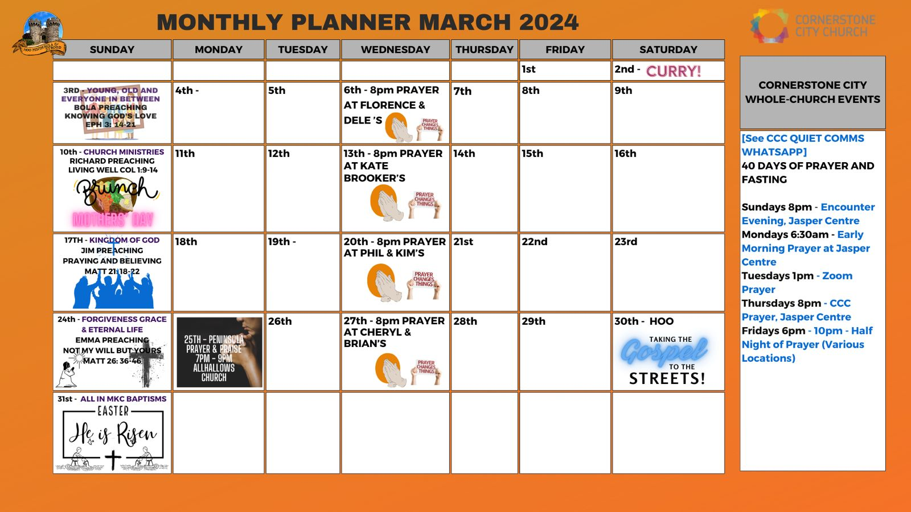

Slide 26


Slide 27
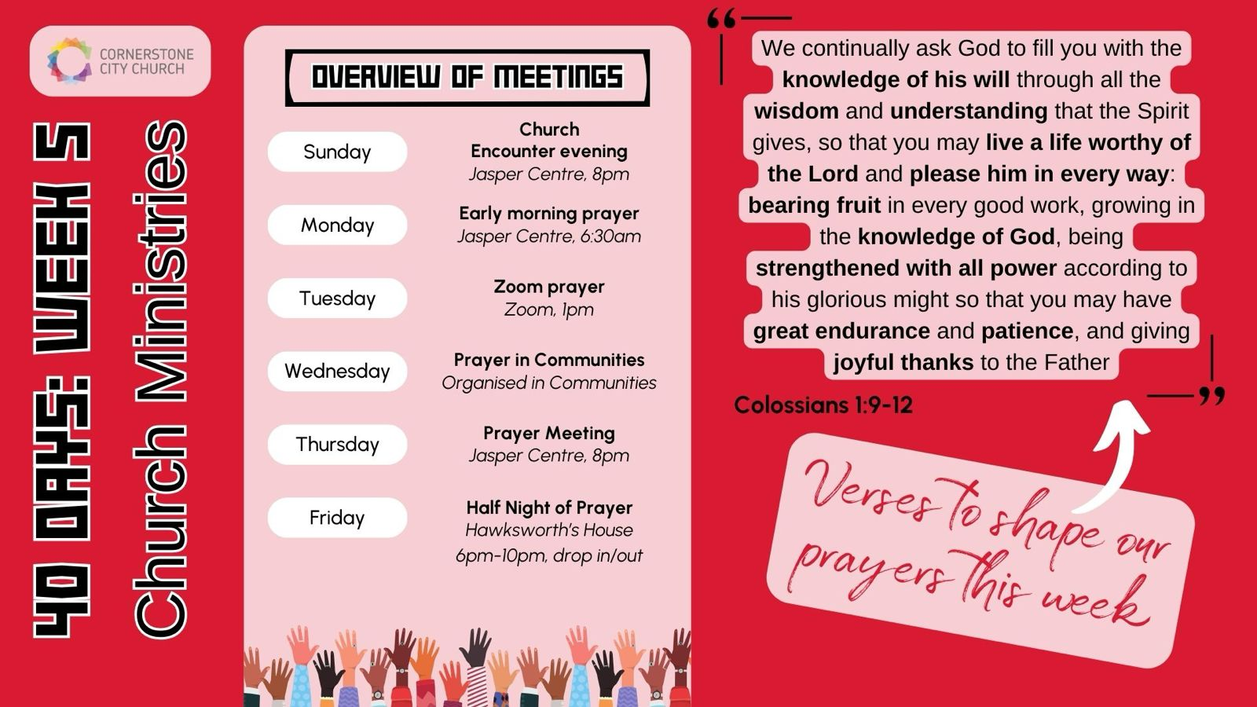

Slide 28


Slide 29


Slide 30


Slide 31
2 Corinthians 14 May the grace of the Lord Jesus Christ, and the love of God, and the fellowship of the Holy Spirit be with you all

